Slide 1

Accelerating Clustering using Approximate Spanning Tree and Prime Number based Filter
PC2
Lab
DJ Rao, Sutharzan Sreeskandarajan,
and Chun Liang
raodm@miamiOH.edu

Slide 2
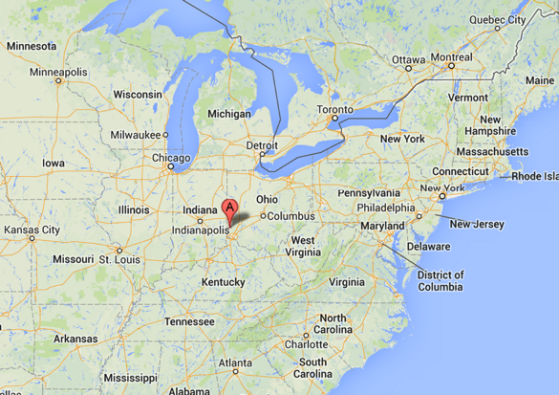
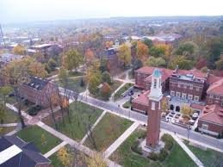

About Miami University
Established in 1809 by ordinance signed by President George Washington in 1795.
One of the oldest public Universities in USA

Slide 3

Popular Miami T-Shirt
Miami was a University when Florida Belonged to Spain

Slide 4
Need for clustering
To infer phylogenetic relationships between organisms
Phylogenetic analyses
Inferring antigenic drift
To aid in NGS data analysis
Speeding up read alignments
Binning of metagenomics reads
Reducing sequencing errors
Pre-clustering 16S RNA reads to reduce PCR errors (Schloss, Gevers, & Westcott, 2011)
Reads to be clustered
Clustering

Slide 5
Clustering approaches
Alignment-based
Alignment-free approaches
Traditional clustering approaches are alignment-based
Dynamic programming
Distance matrices
Pairwise and multiple sequence alignments
Example: MUSCLE (Edgar, 2004)
Considered to be accurate
Common problems:
Runtime (slow)
Larger memory requirements
Harder to incorporate structural features
A popular alternative
No sequence alignments/matrices
Heavy use of heuristics
Use of pseudo-metric distances
Minimize sequence comparisons
Example: CD-Hit (Li & Godzik, 2006)
Less accurate but more practical.
Has the potential to incorporate structural features (e.g. Inverted repeats)

Slide 6
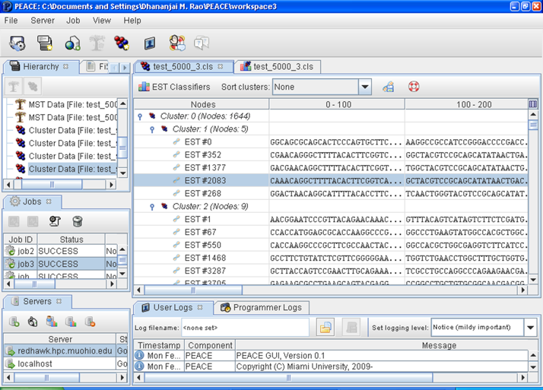
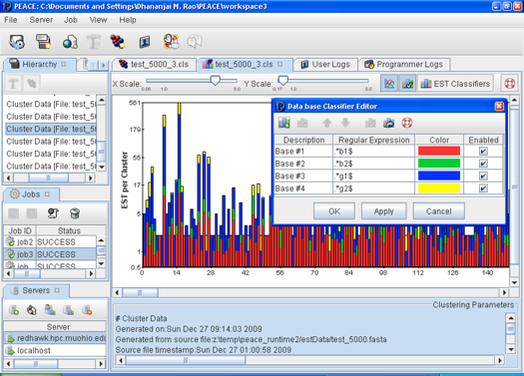
PEACE
Parallel EST Assembly and Clustering Environment (PEACE)
C++/MPI backend for parallel clustering
Composable design to facilitate plug-n-play for different options
Configurable via a comprehensive set of command-line arguments
Textual interactive console for focused analysis
Java GUI frontend
Streamlines PBS job creation and basic visualization

Slide 7
PEACE: MST & D2
PEACE uses Minimum Spanning Tree (MST) for clustering
Uses Prim’s algorithm for MST
MST is then cut at heavy edges to form clusters
D2 is used as the weight for edges in the MST
Identification of nearest neighbor is parallelized
Heuristics are used to minimize D2 computations
r1
0.25
0.27
r2
r3
0.15
r4
2.2
r5
d2
0.3
r5
D2 distance pseudo metric based on number of similar words of length k (k=6nt) within a window of size w (w=100nt) between 2 reads.

Slide 8

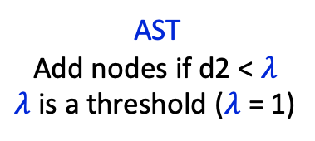
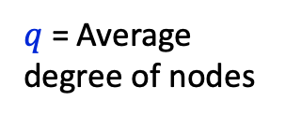
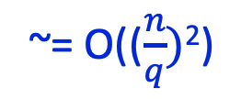

MST vs Approximate Spanning Tree
Minimum Spanning Tree (MST)
Approximate Spanning Tree (AST)
r1
r1
0.25
0.27
0.25
0.27
r2
r3
~= O(($\frac{n}{q})$²)
r2
r3
~= O(n²)
0.15
AST
Add nodes if d2 < $λ$
$λ$ is a threshold ($λ$ = 1)
0.15
r4
r4
$q$ = Average degree of nodes
Parent nodes: 139
Average degree ($q$): 3.59
Parent nodes: 17
Average degree ($q$): 29.35
Data based on 500 HA sequences

Slide 9

Impact of AST threshold ($λ$)

Slide 10
Impact of AST Threshold

Slide 11
Prime Number Heuristic (PNH)
Prime Number Heuristic (PNH)
Objective: Further reduce MST construction time
Minimize number of calls to D2 & improve performance
Σ
Σ

Slide 12
Impact of number of features (more features shorter sequences)

Slide 13
Performance comparisons AST
WCD-KABOOM is one of the fastest clustering software
From Hazelhurst et. al.
Faster than TGICL, PEACE-MST etc. but with comparable quality
Dataset |  | Runtime (Sec) |  | Memory (MB)
Name | Reads | KABOOM | PEACE-AST | KABOOM | PEACE-AST
S8 | ~150K | 61 | 46 (↑ 24%) | 787 | 163 (↑ 4.8×)
C08 | ~100K | 120 | 150 (↓ -16%) | 811 | 2724 (↓3.35×)
A076941 | ~77K | 45 | 114 (↓ 2.5×) | 568 | 2711 (↓4.7×)
Dataset |  | Runtime (Sec) |  | Memory (MB)
Name | Reads | KABOOM | PEACE-AST | KABOOM | PEACE-AST
HA | ~65K | 8995 | 16 (↑ 562×) | 1820 | 178 (↑ 10×)
Dengue | ~5.2K | 1905 | 21 (↑ 90×) | 945 | 78 (↑ 12×)

Slide 14
Performance comparisons AST+PNH
Prime Number Heuristics (PNH)
Used as a filter to reduce the number of D2 comparisons
Currently improves performance for HA & Dengue datasets
With degradation in NMI

Slide 15
Conclusions & Future Work
AST performance summary
Significantly outperforms for large clusters
Underperformance with many small clusters
Future work: Identify the threshold when AST performs better
AST+PNH: Improves performance in certain cases
Future work : Identify types of data sets where PNH performs better without significant degradation
Explore parallel clustering capabilities of PEACE

Slide 16
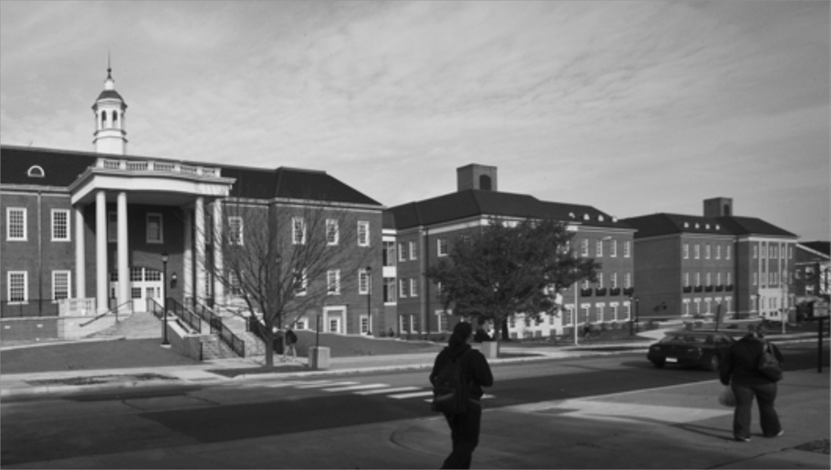




Thank you! Questions?
DJ Rao
Associate Professor
Computer Science & Software Engineering Department
Sutharzan Sreeskandarajan
Ph.D. Candidate
Biology department
Chun Liang
Professor
Biology Department

